Slide 1


Slide 2
We generate our own environment. We get exactly what we deserve. How can we resent the life we have created for ourselves? Whose to blame ,but us? Who can change it anytime we wish ,but us ?
Richard bach

Slide 3
Unit 6-Human System And Environment 6.1 Ecology and Biosphere
Prepared By:
Suruchi Regmi
BNS 2nd year
Roll no -24
TU.IOM.PNC
Teaching Learning Practicum
2080/09/01-2080/11/

Slide 4
General objectives
At the end of this teaching session, BNS first year students will be able to explain about ecology and biosphere.

Slide 5
Specific Objectives
At the end of this session participants will be able to:
introduce ecology
state the laws of ecology
explain the component of biosphere
state the composition of biosphere
introduce the interaction of human population in biosphere
introduce impact of ecology.

Slide 6
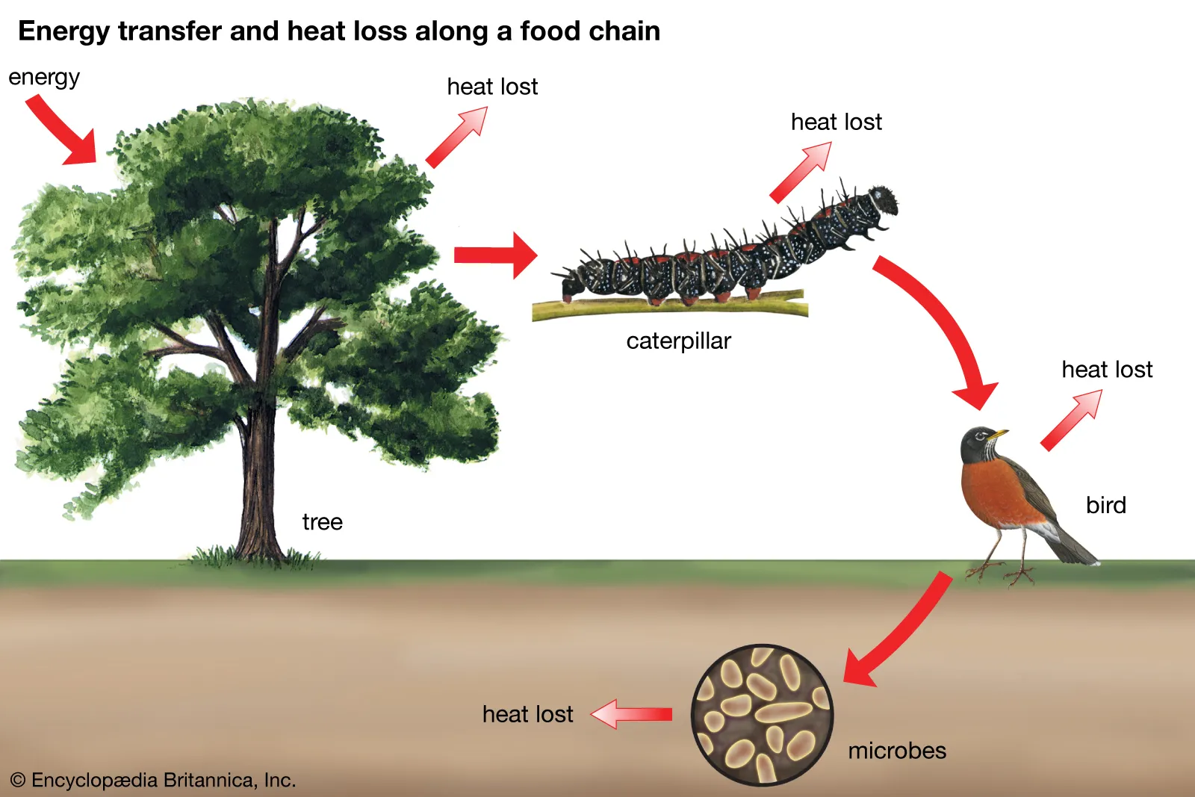

Slide 7
Ecology
The term ecology was first purposed by German biologist Ernst Haeckel in 1869; the word is derived from the Greek root ‘oikos’ which means house and ‘Logos’ which means study of organisms at home.
According to Warming (1895,1905); “Ecology is the study of organism in relation to the environment”.

Slide 8
According to Tyler (1936); “Ecology as the science of all the relations of all the organisms to all their environment”.
According to Wood burg (1954);” Ecology is a science which investigate organism in relation to their environment, a philosophy in which the world of life is interpreted in terms of natural process”.

Slide 9
In 1985, krebs gave a definition as ‘’ Ecology is the scientific study of interactions that determine the distribution and abundance of organisms’’. However, the modern ecology develops the following facts;
The biotic (living) and abiotic (non-living) components of nature are interrelated and works in an orderly manner as a definite system.

Slide 10
Ecology can be referred as surrounding or environment of an organism it studies the relationship between organism and their environment which includes the cycle of water, oxygen, air.
It is a basic division of biology and consists of population, communities and eco system. E.g. forest ecosystem , land ecosystem, aquatic ecosystem

Slide 11
Laws of ecology
Barry Commoners ‘law of ecology ‘(1971) helps to explain the scope of environment health. According to him;
1. “Everything is connected to everything else” sunlight, water, oxygen, carbon dioxide. Organic compound and all organism are interconnected.
2.“Everything must go” stipulates that one organism’s excretion or waste is taken up by another organism as food.

Slide 12
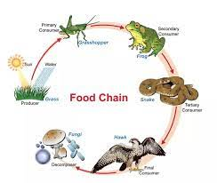
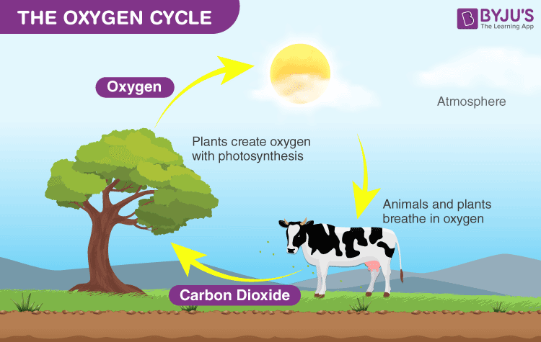

Slide 13
3.“Nature knows best” holds that human changes within a natural system do not always improve that system and may prove to be detrimental.
4.“There is no such thing as free lunch” stipulates that anything removed from natural environment by human effort must be replaced and anything added to the natural environment must be removed if environment is to be preserved.

Slide 14
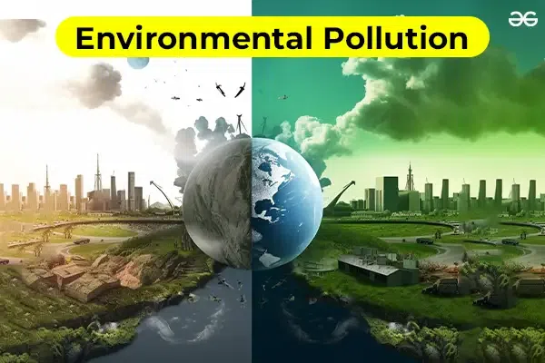

Slide 15
Biosphere
The biosphere is a thin layer of air, water and soil on the earth within which all the living beings are exist.
A biosphere is that part of planet terrestrial system – including air, land, and water in which life develops and transforms.
The biosphere is the global ecological system integrating all living beings and their relationships, with their interaction with the elements of lithosphere(rocks), hydrosphere(water), and the atmosphere(air).

Slide 16
It extends vertically in the atmosphere to about 10km, downward into the ocean to depth of 35000 feet and enters about 23000 feet of earth surface itself where living organisms have been found.
The structure of Biosphere has three components: Abiotic, Biotic and energy components.

Slide 17
I. Abiotic Components: It consists of all non-living elements which are essential for the survival of all living organisms. It has lithosphere, atmosphere and hydrosphere. Mineral nutrients, gases and water are three basic requirements of organic life.
II. Biotic Components: It includes Plants, animals and human beings to make biotic components of environment. there are three sub-system: plants, animals ,micoorganisms

Slide 18
Plants: They are very important part of biotic components. They are primary producers of food through process of photosynthesis. They are called autotrophs.
Animals: They are main consumers of plant produce, hence known as Heterotrophs. They use organic matter produced by plants and transform the food into energy (used in growth and development).

Slide 19
Micro-organism: They act as decomposers of dead plants and animals
III. Energy: It is vital component of biosphere which is essential for reproduction and generation of all biological life on Earth.

Slide 20
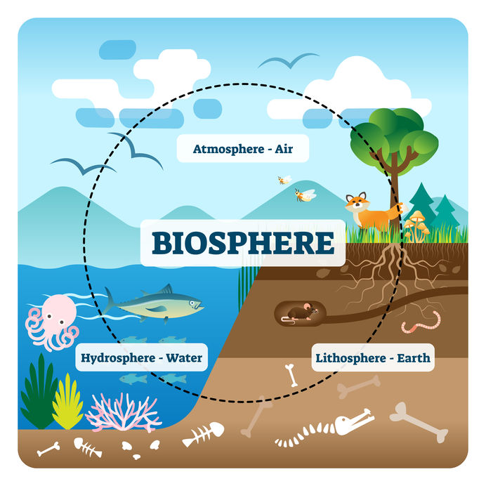

Slide 21
Composition of biosphere
1. Atmosphere : One of the main component of Earths interdependent physical systems is the atmosphere.
An atmosphere is made of the layer of gases surrounding a planet or celestial body. Earth’s atmosphere is composed of about 78% nitrogen ,21% oxygen, and one percent other gases.
It can be divided in four zones

Slide 22
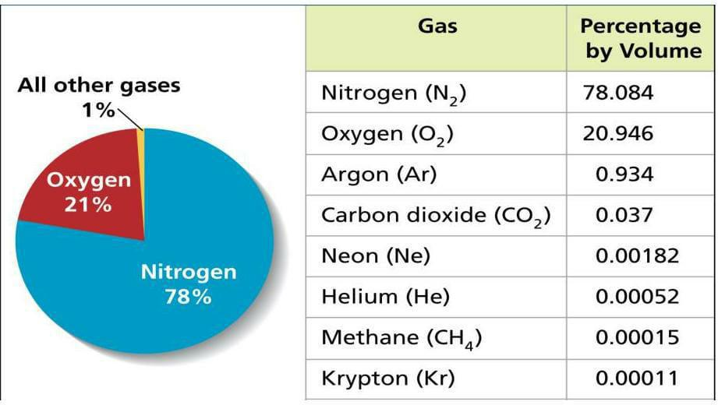

Slide 23
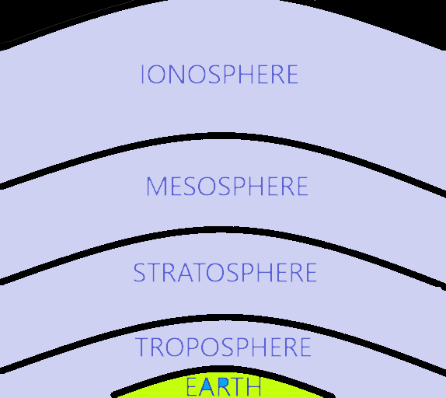
s

Slide 24
Troposphere; It is a basal part which is about up to 20km above the earth surface. It is important zone for living organism. The important event is cloud formation, lightening, thundering, and storm formation. Air temperature gradually decrease with height at rate of about 6.5 degree Celsius per Km in upper layers; temperature might decrease up to -60*F.

Slide 25
Stratosphere; It is the second zone about 30 Km height, where temperature values show an increase up to 90*C. This increase in temperature is due to ozone formation under influence of ultraviolet component of sunlight.
Mesosphere; About 40km in height in this zone temperature shows again decrease up to 80*C.

Slide 26
Ionosphere; Rest above the mesosphere up to the height of 300 km above the earth surface gases component become ionized under the influence of radiant energy.

Slide 27
2. Geosphere : also called lithosphere and is the layer that is covering the planet. It is the solid, outer part of the earth, including the brittle upper portion of mantle and crust.
The lithosphere interacts with all the sphere. It provides biosphere with minerals in soil or water that have been dissolved through hydrosphere-lithosphere interaction.
The lithosphere, due to its landforms also has an impact on the weather and how the water flows.

Slide 28
3. Hydrosphere : is the combined mass of water found on, under, and above the surface of a planet.
Hydrosphere includes following;
Oceans
Fresh water; surface water and ground water
Glacial water
Atmospheric water

Slide 29
4. Human System
The human system in addition to natural environment includes all the dimension of man-made environment physical, chemical, biological, in short, our culture and product.
Besides ecology and biology this discipline involves many other natural and social sciences, such as anthropology, ethnology, economics, demography, architecture, and many more.
It is made up of 3 components

Slide 30
Technology; Human are enabling to control the environment through extraction, transportation, and communication.
Psychosocial; It includes language, experiences, social morale, interpersonal relationship, collective pattern of behavior, social institutions, symbolic and ideological system.
Biophysical; Biophysical and metabolic process, organic life style, for example birth and ageing death of individual generations and populations etc.

Slide 31
4.Environmental system; It consist of urbanization, industrialization ,eco-system, food chain, energy cycle chain, water cycle, life cycle of animals etc.

Slide 32
Interaction of human population in biosphere
The entire environment has been a vital part of our existence. The interrelationship between the person and environment are dynamic and each demands on other continuously, people try to adapt to the environment or adapt their needs and desires to meet the current state of the environment which is continuous process but not all adaptations are smooth or positive in outcome.

Slide 33
The different component of biosphere interact in a orderly manner and it is a factors that ensures the survival and growth of biotic elements. The human population has direct interaction and lives within biosphere to obtain food and better facilities, human population do contamination and destructive activities.

Slide 34
Any adverse effects of the balance of the biosphere caused by human exploitation of natural resources can lead to the unfavorable condition for the wellbeing or even survival of mankind.
Human activities such as burning, fossils, fuel, surface mining of coal and incineration of solid waste or manufacturing process are recognized as sources of pollution and they present a world problem.

Slide 35
Impact of ecology on health
Positive ecological factor
Fresh air
Light
Forest
Oxygen
Drinkable water.

Slide 36
Negative ecological factors
Polluted environment
Population explosion
Physical hazard (radiation, noise ,solid waste ,accidents ,insects and rodents
Chemical hazard

Slide 37
Environmental hazards
Many changes disrupt the cycle of life
The relationship between health and environment are described in two contexts.
1. The first includes elements of natural environmental hazards to health such as biological agents of disease or injury, including microorganism, plants and animals, weather, radiation

Slide 38
2.The second includes of health hazard brought on by the actions and maladaptation of people to their environment which includes suicide, accidents, genetic damage, poisoning.

Slide 39


Slide 40
Post test
1………. is the study of organism in relation to the environment.
Answer =Ecology
2………..is the thin layer of air water and soil on earth within which all living things are exists.
Answer =Biosphere

Slide 41
3…………is the combined mass of water found on, under, and above the surface of a planet.
Answer =Hydrosphere
4………… consists of all non-living elements which are essential for the survival of all living organisms.
Answer =Abiotic components

Slide 42


Slide 43
Home assignment
Read the recent research regarding the changes of atmosphere due to human activities.

Slide 44
Plan for next class
We will read about the effect of chemical and physical agents on living organism

Slide 45
References
Rai L, (2015), Nursing Concepts Theories and Principles, 3rd Edition , TaraBooks and Stationery, Chhatrapati, Kathmandu page no 74-76.
Sharma M, (2019), Nursing Concepts and Principles ,3rd Edition, Samiksha Publication Pvt .Ltd. page no 369-375.

Slide 46
Murray R B, Zentner J R, (1985) ,Nursing Concepts For Health Promotion ,3rd edition, The Asian foundation ,page no 369-371.
Acharya K D, Pokharel D K, (2019) Nursing Concepts and Principles, 2nd Edition, Jupiter Publishers and Distributor Pvt.Ltd.
https://nurseinnursing.com
https: brooksidepress.org

Slide 47


